Slide 1
C Language Lecture - 3

Slide 2
Float datatype
Float data type allow a variable to store decimal value (real number) with 6 digit precision.
There are three standard floating-point types in C:
float: for numbers with single precision.
double: for numbers with double precision.
long double: for numbers with extended precision.

Slide 3
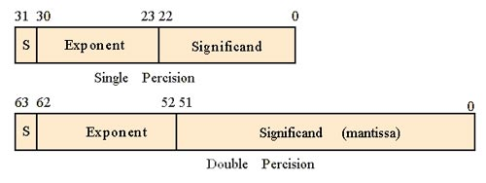
What is precision
For example, the float type with 4 bytes = 4 x 8 bits = 32 bits, is for numbers with single precision. It means that a float gives 1 sign bit, 8 bits of exponent and 23 bits of significand
.
The double type is for a number with the double precision that gives 1 sign bit, 11 bits of exponent and 52 bits of significand. (8 bytes x 8 bits = 64 bits = 1 bits + 52 bits + 11 bits).

Slide 4
Range and precision
In order to find the value ranges of the floating-point number in your platform, you can use the float.h header file. This header file defines macros such as FLT_MIN, FLT_MAX and FLT_DIG that store the float value ranges and precision of the float type.
You can also find the corresponding macros for double and long double with the prefixes DBL_ and LDBL_

Slide 5
Example
#include <conio.h>
#include <stdio.h>
#include <float.h>
void main()
{
printf("size of float %d\n",sizeof(float));
printf("Minimum float value : %E\n",FLT_MIN);
printf("Maximum float value : %E\n",FLT_MAX);
printf("precision float value : %d\n",FLT_DIG);
getch();
}

Slide 6
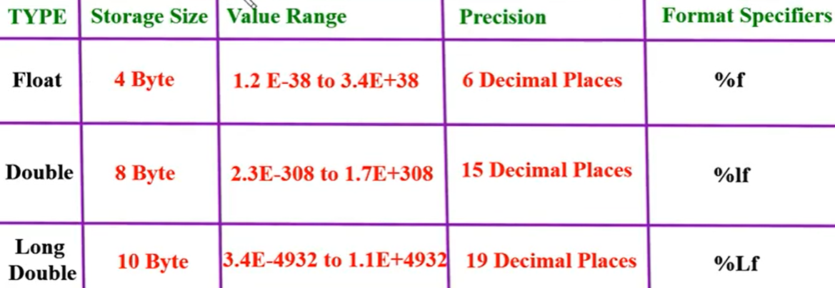

Slide 7
Char datatype
char keyword is used to refer character data type.
Character data type allows a variable to store only one character.
The storage size of character data type is 1(32-bit system). We can store only one character using character data type.
For example, 'A' can be stored using char datatype. You can't store more than one character using char data type.

Slide 8
Type | Size (bytes) | Format Specifier
int | at least 2, usually 4 | %d, %i
char | 1 | %c
float | 4 | %f
double | 8 | %lf
short int | 2 usually | %hd
unsigned int | at least 2, usually 4 | %u
long int | at least 4, usually 8 | %ld, %li
long long int | at least 8 | %lld, %lli
unsigned long int | at least 4 | %lu
unsigned long long int | at least 8 | %llu
signed char | 1 | %c
unsigned char | 1 | %c
long double | at least 10, usually 12 or 16 | %Lf

Slide 9
#include <stdio.h>
int main()
{
int a = 1;
char b = 'G';
double c = 3.14;
printf("Hello World!\n");
// printing the variables defined
// above along with their sizes
printf("Hello! I am a character. My value is %c and "
"my size is %lu byte.\n",
b, sizeof(char));
// can use sizeof(b) above as well
printf("Hello! I am an integer. My value is %d and "
"my size is %lu bytes.\n",
a, sizeof(int));
// can use sizeof(a) above as well
printf("Hello! I am a double floating point variable."
" My value is %lf and my size is %lu bytes.\n",
c, sizeof(double));
// can use sizeof(c) above as well
printf("Bye! See you soon. :)\n");
return 0;
}

Slide 10
Operators
C provides a rich operator environment. An operator is a symbol that tells the computer to perform certain mathematical or logical manipulation. Operators are used in the program to manipulate data and variables. They usually form a part of the mathematical or logical expression.
C language operators can be divided into following categories:
Arithmetic Operators
Relational Operators
Bitwise Operators
Logical Operators
Assignment Operators
conditional operator
Misc Operators

Slide 11
Arithmetic Operator
The basic arithmetic operations in C Programming are addition, subtraction, multiplication, and division.
Arithmetic Operations are operated on Numeric Data Types as expected.
Arithmetic Operators are “Binary” Operators i.e they operate on two operands. These operators are used in mathematical expressions in the same way that they are used in algebra.

Slide 12
Operator | Description | Example
+ (Addition) | Adds two operands | 5 + 10 =15
- (Subtraction) | Subtract second operands from first. Also used to Concatenate two strings | 10 - 5 =5
* (Multiplication) | Multiplies values on either side of the operator. | 10 * 5 =50
/ (Division) | Divides left-hand operand by right-hand operand. | 10 / 5 =2
% (Modulus) | Divides left-hand operand by right-hand operand and returns remainder. | 5 % 2 =1
++ (Increment) | Increases the value of operand by 1. | 2++ gives 3
-- (Decrement) | Decreases the value of operand by 1. | 3-- gives 2

Slide 13
Relational Operator
Relational Operators are used to checking relation between two variables or numbers.
Relational Operators are Binary Operators.
Relational Operators returns “Boolean” value .i.e it will return true or false.
Most of the relational operators are used in “If statement” and inside Looping statement in order to check truthiness or falseness of condition.

Slide 14
Operators | Descriptions | Examples
== (equal to) | This operator checks the value of two operands, if both are equal, then it returns true otherwise false. | (2 == 3) is not true.
!= (not equal to) | This operator checks the value of two operands, if both are not equal, then it returns true otherwise false. | (4 != 5) is true.
> (greater than) | This operator checks the value of two operands, if the left side of the operator is greater, then it returns true otherwise false. | (5 > 56) is not true.
< (less than) | This operator checks the value of two operands if the left side of the operator is less, then it returns true otherwise false. | (2 < 5) is true.
>= (greater than or equal to) | This operator checks the value of two operands if the left side of the operator is greater or equal, then it returns true otherwise false. | (12 >= 45) is not true.
<= (less than or equal to) | This operator checks the value of two operands if the left side of the operator is less or equal, then it returns true otherwise false. | (43 <= 43) is true.

Slide 15
The Bitwise Operators
Operator | Description | Example
& (bitwise and) | Bitwise AND operator give true result if both operands are true. otherwise, it gives a false result. | (R & S) will give 12 which is 0000 1100
| (bitwise or) | Bitwise OR operator give true result if any of the operands is true. | (R | S) will give 61 which is 0011 1101
^ (bitwise XOR) | Bitwise Exclusive-OR Operator returns a true result if both the operands are different. otherwise, it returns a false result. | (R ^ S) will give 49 which is 0011 0001
~ (bitwise compliment) | Bitwise One's Complement Operator is unary Operator and it gives the result as an opposite bit. | (~R ) will give -61 which is 1100 0011 in 2's complement form due to a signed binary number.
<< (left shift) | Binary Left Shift Operator. The left operands value is moved left by the number of bits specified by the right operand. | R << 2 will give 240 which is 1111 0000
>> (right shift) | Binary Right Shift Operator. The left operands value is moved right by the number of bits specified by the right operand. | R >> 2 will give 15 which is 1111

Slide 16
Logical Operators
Operator | Description | Example
&& (logical and) | If both the operands are non-zero, then the condition becomes true. | (0 && 1) is false
|| (logical or) | If any of the two operands are non-zero, then the condition becomes true. | (0 || 1) is true
! (logical not) | Logical NOT Operator Use to reverses the logical state of its operand. If a condition is true then Logical NOT operator will make false. | !(0 && 1) is true

Slide 17
The Assignment Operators
= | assigns values from right side operands to left side operand | A=B
+= | adds right operand to the left operand and assign the result to left | A+=B is same as A=A+B
-= | subtracts right operand from the left operand and assign the result to left operand | A-=B is same as A=A-B
*= | mutiply left operand with the right operand and assign the result to left operand | A*=B is same as A=A*B
/= | divides left operand with the right operand and assign the result to left operand | A/=B is same as A=A/B
%= | calculate modulus using two operands and assign the result to left operand | A%=B is same as A=A%B
<<= | Left shift AND assignment operator. | A <<= 2 is same as A = A<< 2
>>= | Right shift AND assignment operator. | A >>= 2 is same as A = A >> 2
&= | Bitwise AND assignment operator. | A &= 2 is same as A = A & 2
^= | bitwise exclusive OR and assignment operator. | A ^= 2 is same as A = A ^ 2
|= | bitwise inclusive OR and assignment operator. | A |= 2 is same as A = A | 2

Slide 18
Miscellaneous Operators
C includes a one of the most special ternary (three-way) operator that can replace certain types of if-then-else statements. This operator is the ? .
It can seem somewhat confusing at first,
but the ? can be used very effectively once mastered. The ? has this general form:
Expression1 ? Expression2 : Expression3
Expression ? value if true : value if false
void main() {
int a, b; a = 20;
b = (a == 1) ? 10: 25;
printf( "Value of b is : %d\n",b );
b = (a == 20) ? 20: 30;
printf( "Value of b is : %d\n",b );
}

